Slide 1
Australian insights on income dynamics from administrative data (2002-2022)
GRID Project Update
Matt Elias
08/11/2024

Slide 2
Introduction

Slide 3
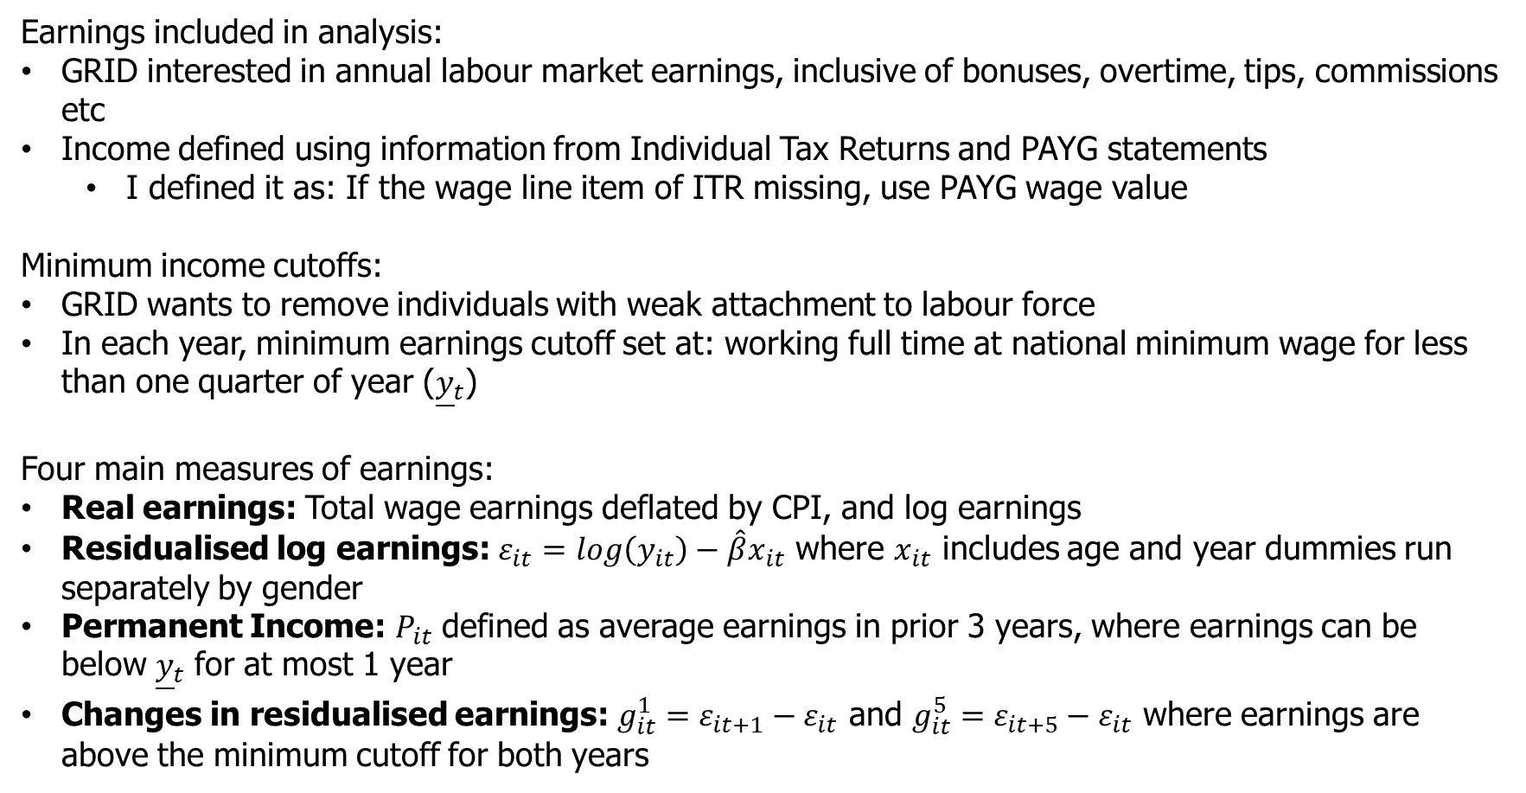
Variable construction
Earnings included in analysis:
GRID interested in annual labour market earnings, inclusive of bonuses, overtime, tips, commissions etc
Income defined using information from Individual Tax Returns and PAYG statements
I defined it as: If the wage line item of ITR missing, use PAYG wage value
Minimum income cutoffs:
GRID wants to remove individuals with weak attachment to labour force
In each year, minimum earnings cutoff set at: working full time at national minimum wage for less than one quarter of year (${\underline{y}}_{t}$)
Four main measures of earnings:
Real earnings: Total wage earnings deflated by CPI, and log earnings
Residualised log earnings: $ε_{it}=log\left(y_{it}\right)−\hat{β}x_{it}$ where $x_{it}$ includes age and year dummies run separately by gender
Permanent Income: $P_{it}$ defined as average earnings in prior 3 years, where earnings can be below ${\underline{y}}_{t}$ for at most 1 year
Changes in residualised earnings: $g_{it}^{1}=ε_{it+1}−ε_{it}$ and $g_{it}^{5}=ε_{it+5}−ε_{it}$ where earnings are above the minimum cutoff for both years

Slide 4
E61 GRID Team
Matt Elias:
Pre-doctorate economist at e61.
Has undertaken the GRID work in our datalab environment.
Gianni La Cava:
Research Director at e61.
Constructed the initial LEED used for analysis.
Greg Kaplan:
Co-founder of e61, Professor at UoC, and head of e61 board.
Provided advice and support for undertaking the project.
Matt Nolan:
Research Manager at e61.
Provided oversight and suggestions on project, presenting today.

Slide 5
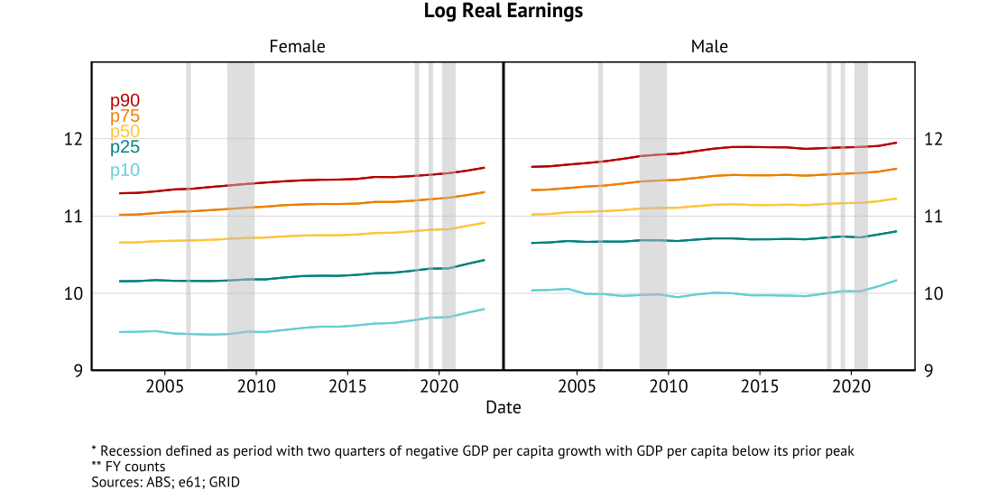
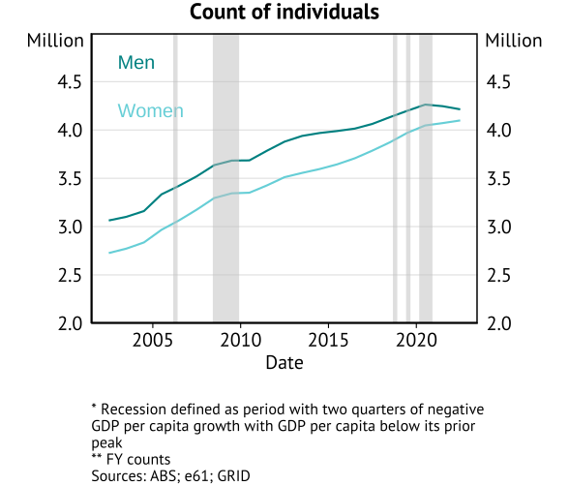
Australia sample summary
8.3m individuals in 2021 (Census 2021 for group = 10.6 million)

Slide 6
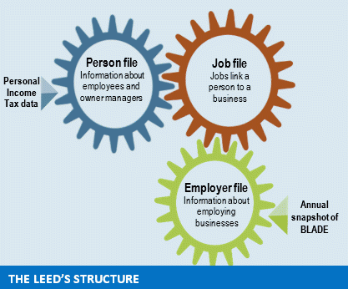
Australia microdata
LEED individuals:
Personal ‘spine’ of data based on linking of Census, tax records, benefit records, health records (Medicare), visa records.
Business ‘spine’ of data uses business tax – both income tax and withholding taxes (withholding on labour income, broad-based consumption tax).
Data structure (ABS provided Datalab)
2002-2022 FY (June years) data available for LEED
Comprehensive but misses:
Self-employed (who report through business or personal service income), informal work, or low-income small business employees.
Those who predominantly earn from untaxed benefits.
We have not incorporated the full benefit data for this project at this stage.

Slide 7
Data construction
Start with a LEED file based on business tax reporting and household tax returns:
Includes all tax-filers in Australia (will include temporary migrants).
Collapse wage income across all firms in each financial year (inclusive of all wage and salary items), deflate by CPI
If PAYG value (jobs file) is missing, use individual value from Individual Tax Return (person file)
Merge in demographics file
Sample used:
Individuals aged between 25 and 55
Individuals with meaningful attachment to the labour force who earn above a cutoff: working at least one quarter of year part-time at the national minimum wage in each financial year (varies from award wages).
Full sample used.

Slide 8
Australia microdata and specific coding issues
Bottom coding:
Occurs due to non-filing of tax returns below the tax-free threshold.
Worsened by increase in tax-free threshold in 2012 (from $6,000 to $18,200).
Use PAYG data (jobs file) as primary source to address this in part.
Top coding:
Values above an earnings level are censored by the ABS – individual kept, but income is set to top-coded value.
Top coded value changes depending on variable and changes across different years.
Datalab recommendations is to only release data based on top coding at a nominal $1 million per job per year.
Total taxable income top coded to $6 million pa.
Data structure

Slide 9
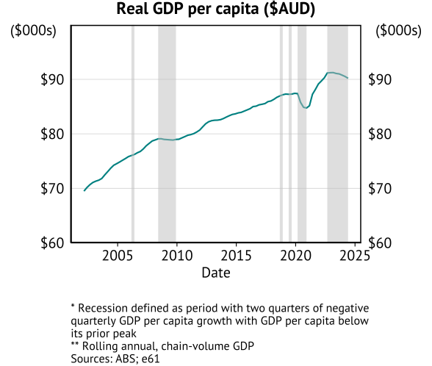
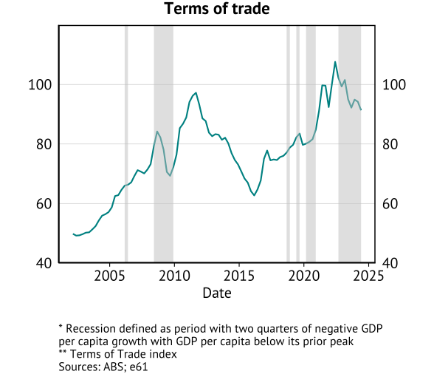
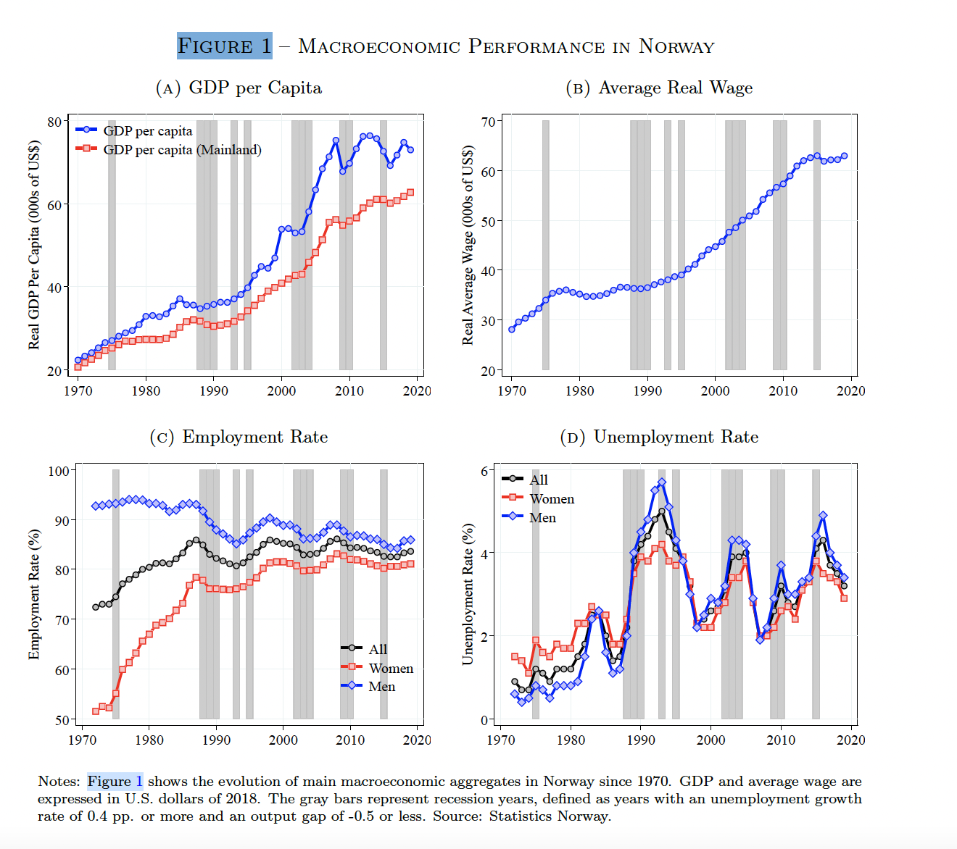
Macroeconomic performance
Australian macro context:
Only one “GDP recession” in 30 years (population growth)
End of mining boom (post-2012)

Slide 10
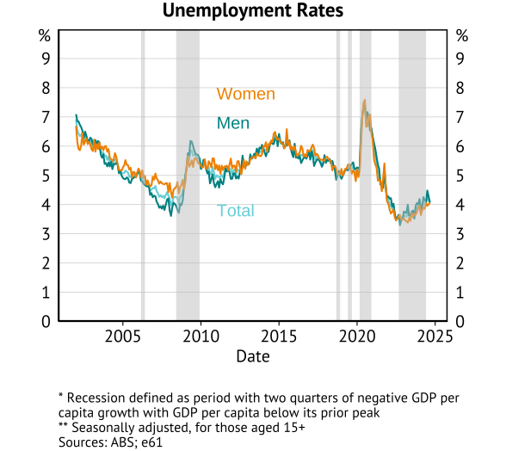
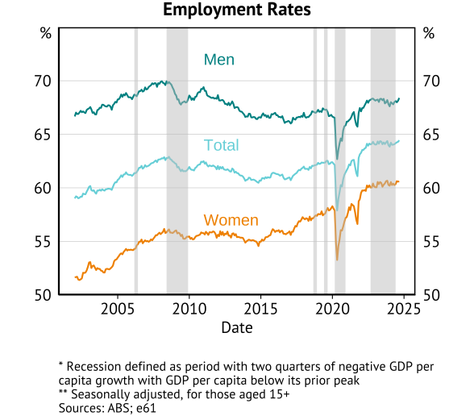
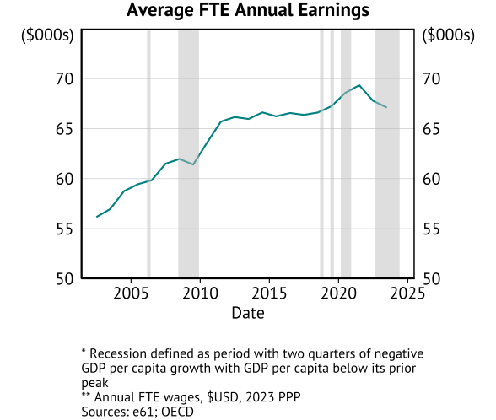
Macroeconomic performance

Slide 11
Inequality

Slide 12
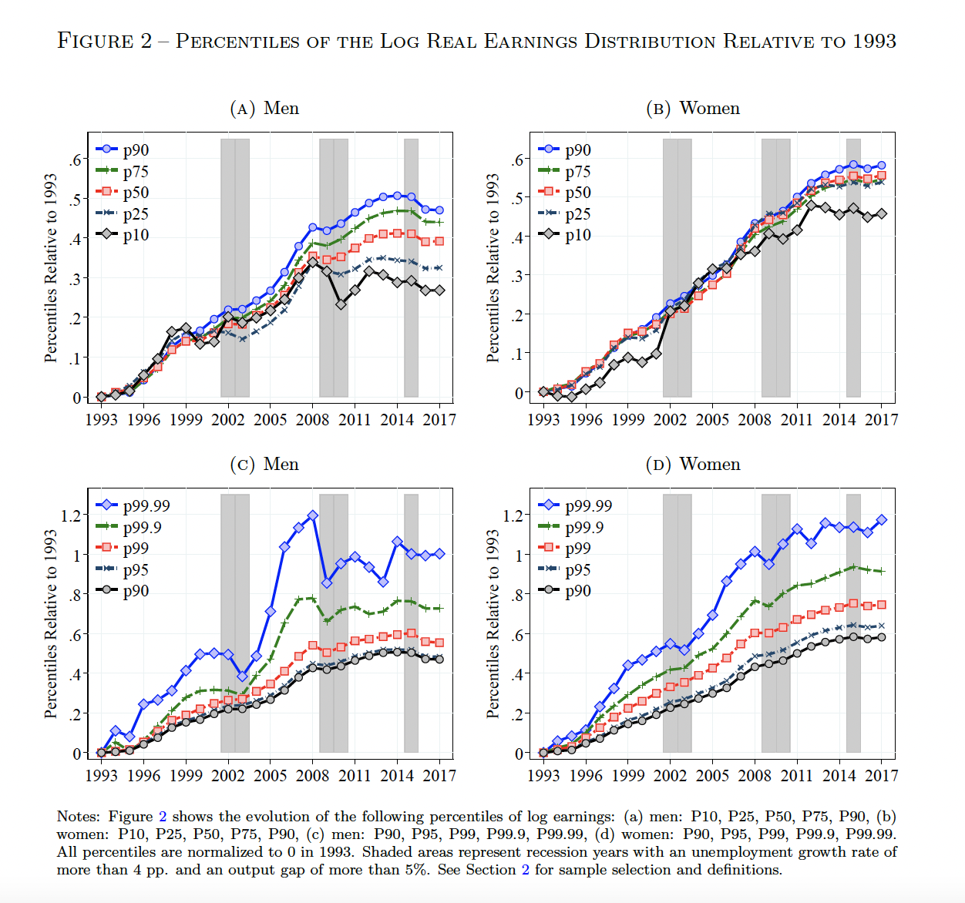
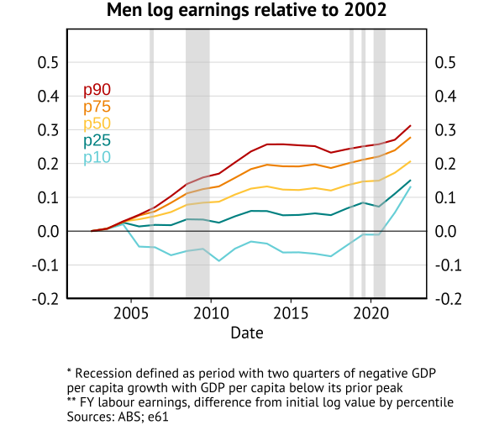
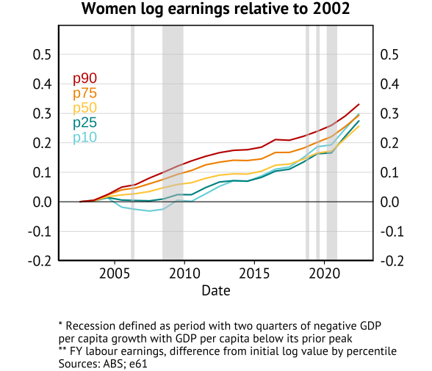
Percentiles of the Log Real Earnings Distribution relative to 2002

Slide 13
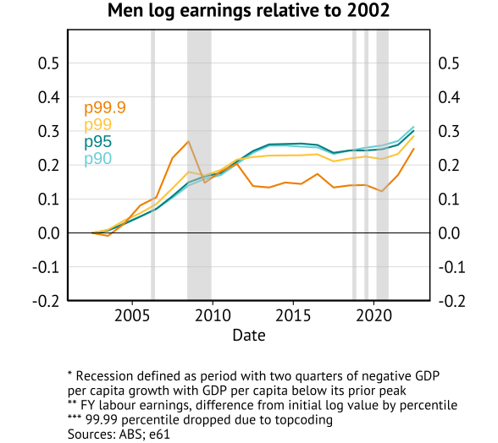
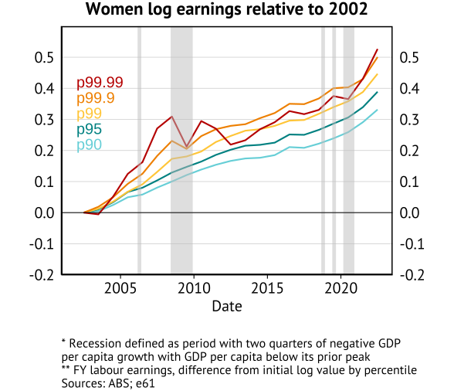
Percentiles of the Log Real Earnings Distribution relative to 2002

Slide 14
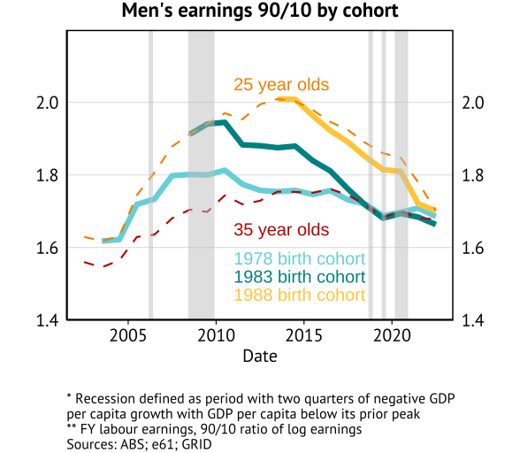
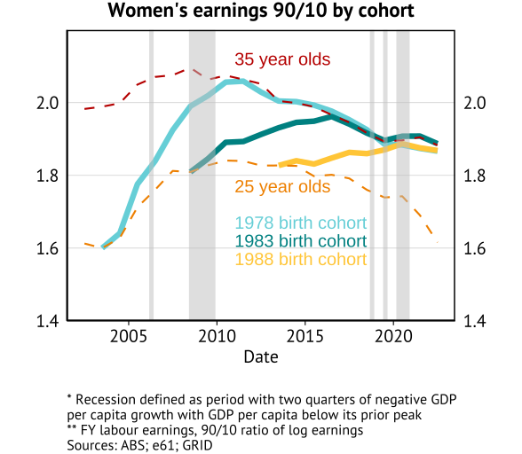
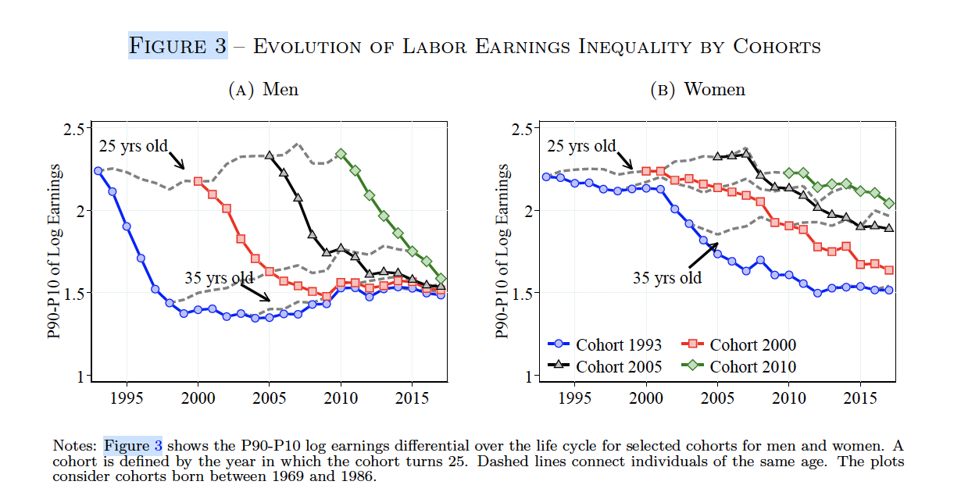
Evolution of Labour Earnings Inequality by Cohort

Slide 15
Volatility

Slide 16
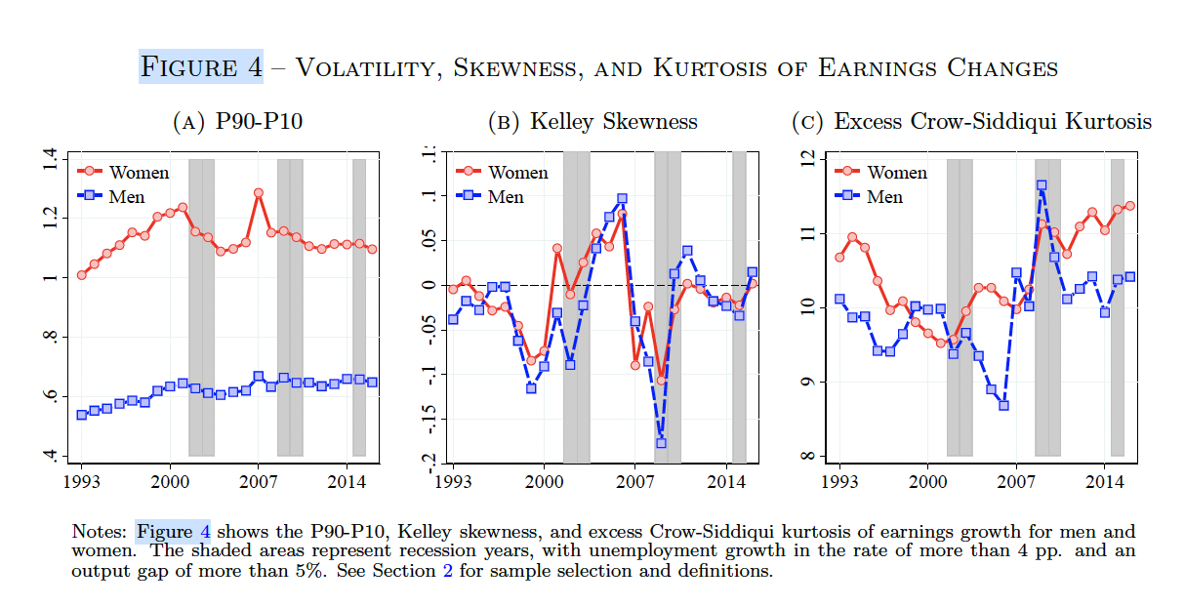
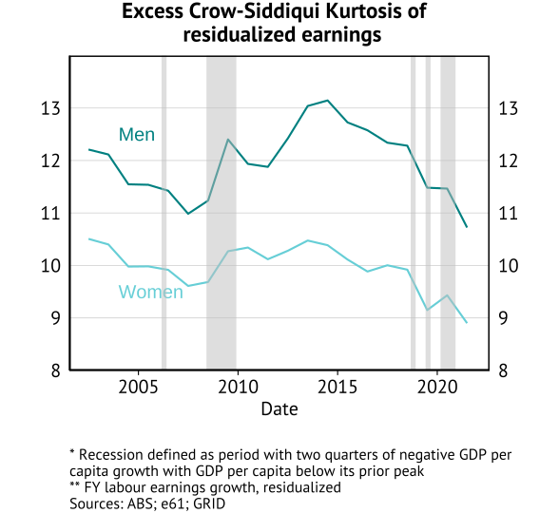
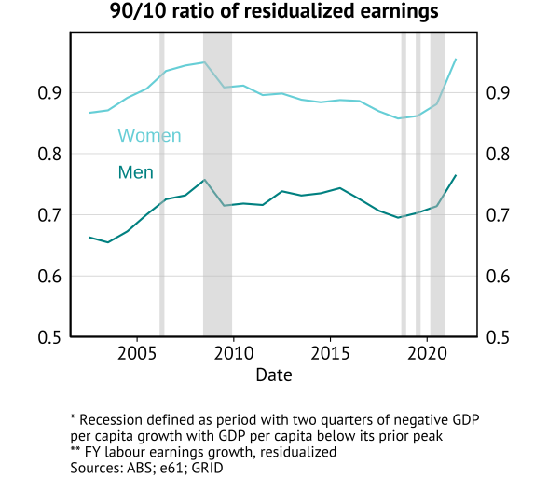
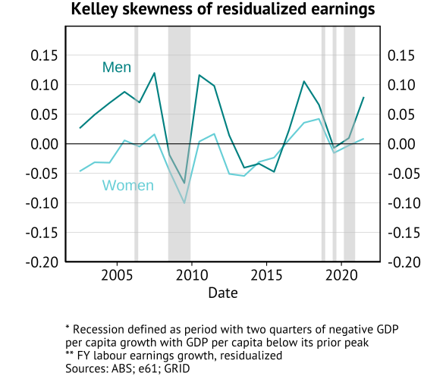
Distribution of one-year growth of residualized earnings

Slide 17
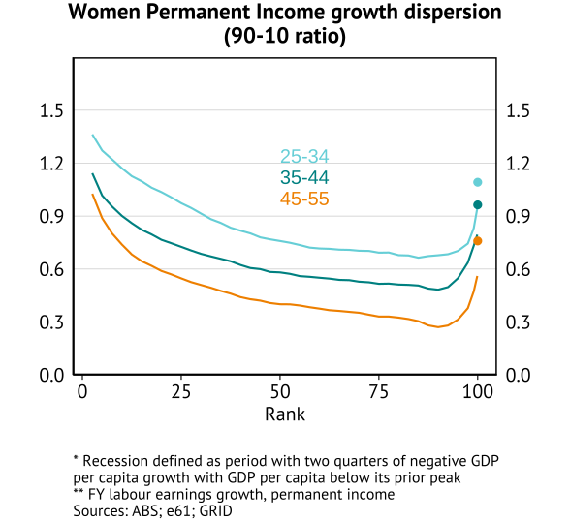
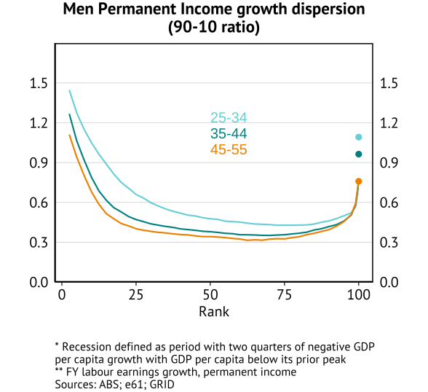
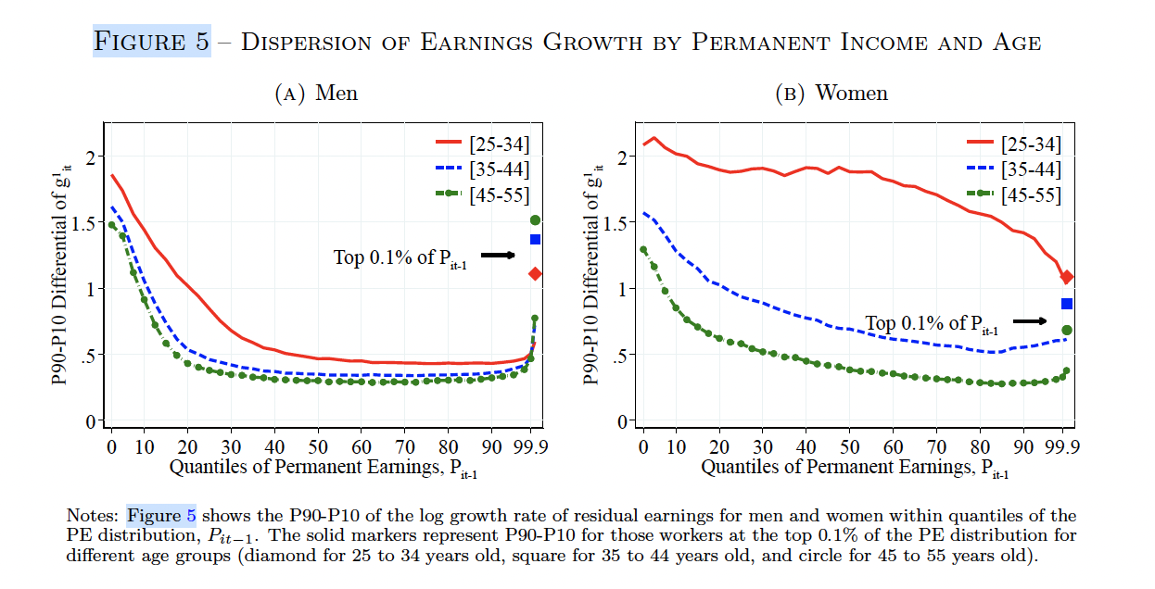
One-year growth of residualized earnings by permanent income

Slide 18
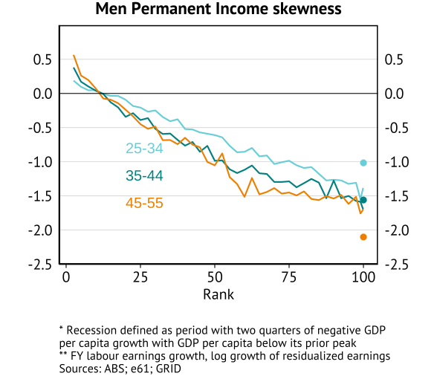
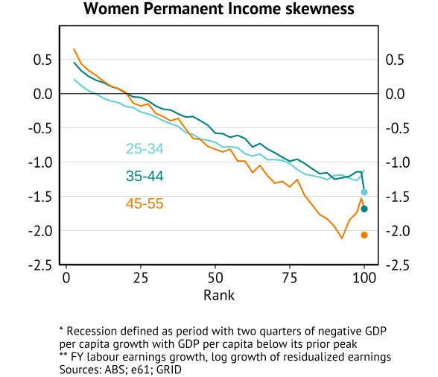
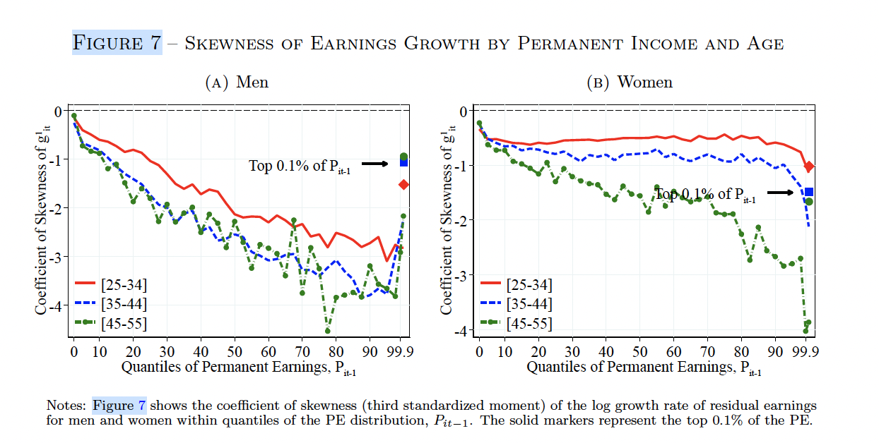
One-year growth of residualised earnings by permanent income

Slide 19
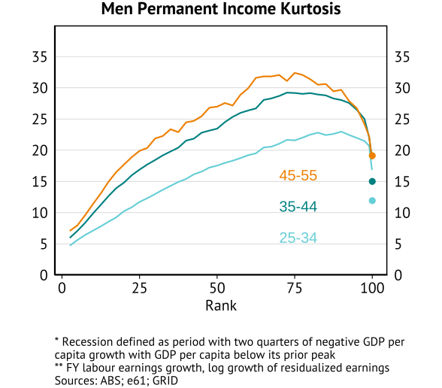
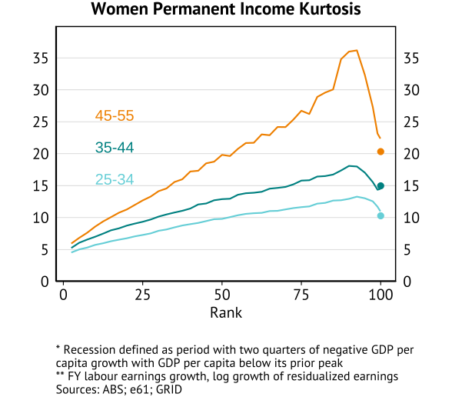
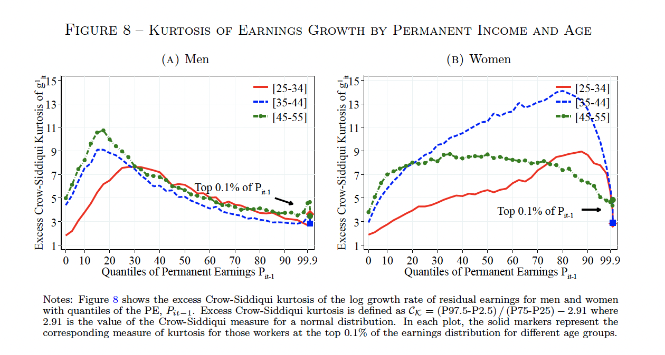
One-year growth of residualised earnings by permanent income

Slide 20
Mobility

Slide 21
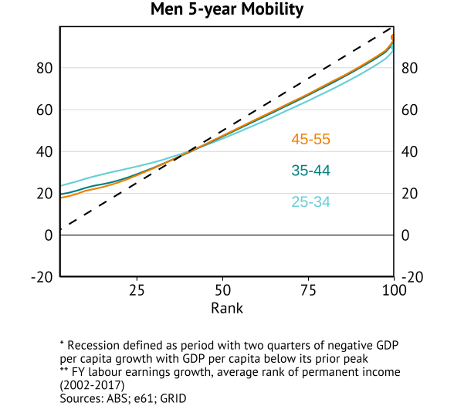
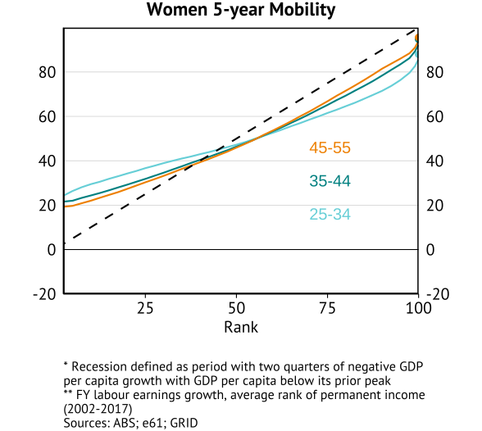
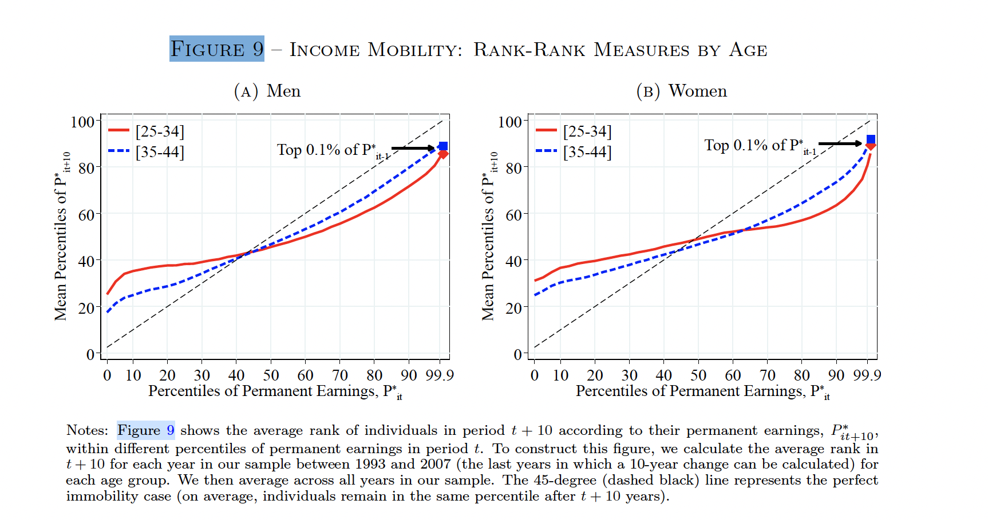
Rank-rank mobility within permanent income distribution
Rank-rank statistic
25-34 Male: 0.660
35-44 Male: 0.759
45-55 Male: 0.782
Rank-rank statistic
25-34 Female: 0.566
35-44 Female: 0.709
45-55 Female: 0.765

Slide 22
Appendix

Slide 23
Insert table 1 from grid paper for whats available in the AUS data

